Slide 1
NTM: ELECTRO DISCHARGE MACHINING ME 270
Dr. G. TAKYI

Slide 2
INSTRUCTIONAL OBJECTIVE
Identify electro-discharge machining (EDM) as a particular type of non-tradition processes
Describe the basic working principle of EDM process
Draw schematically the basics of EDM
Describe spark initiation in EDM
Describe material removal mechanism in EDM
Draw the basic electrical waveform used in EDM
Identify the process parameters in EDM
Describe the characteristics of EDM
Identify the purpose dielectric fluid in EDM
List two common dielectric fluid

Slide 3
INSTRUCTIONAL OBJECTIVES
Analyze the required properties of EDM tool
List four common tool material for EDM
Develop models for MRR in EDM
Identify machining characteristics in EDM
Analyze effect of process variable son roughness
Analyze taper cut and over cut in EDM
Identify different modules of EDM systems
Draw schematic representation of different electrical generators used in EDM
Analyze working principle of RC type EDM generator

Slide 4
Classification of NTM Processes
Mechanical Processes
abrasive Jet Mechanism (AJM)
Ultrasonic Machining (USM)
Water Jet Machining (WJM)
Electrochemical Processes
Electrochemical Machining (ECM)
Electro Chemical Grinding (ECG)
Electro Jet Driling (EJD)

Slide 5
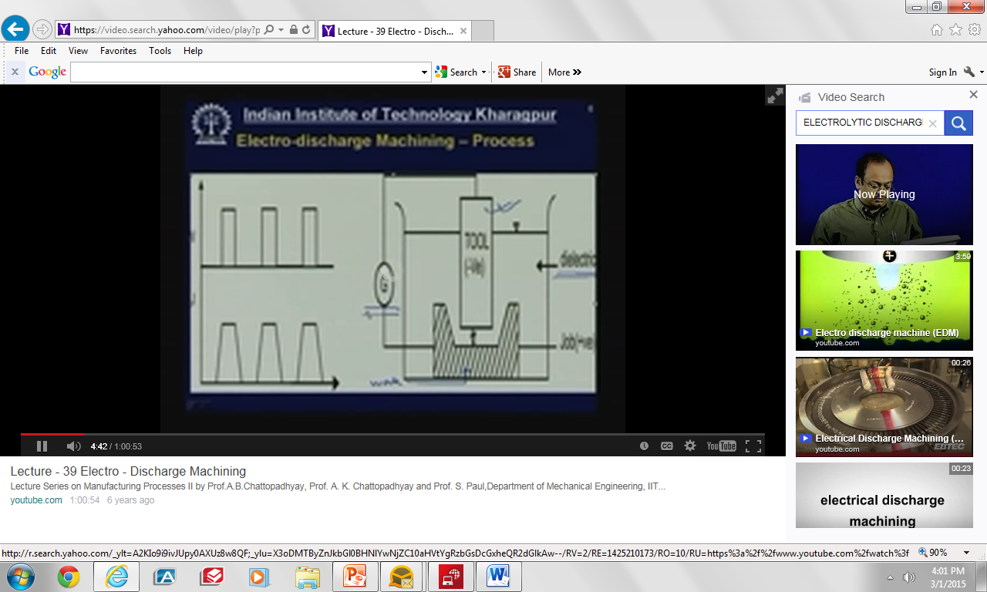

Slide 6
Mechanism of Material Removal
Potential differences
Generally tool negative and work positive
Electric field is established
Tool and work piece-conductor of electricity

Slide 7
Mechanism of Material Removal (CONT’D)
This free electrons are available
If the work function is low, electrons get emitted from tool
Cold emission of electrons and acceleration of same
Collision of electron with dielectric molecules
Secondary and tertiary collision – plasma channel
Avalanche motion of electrons – spark
Impingement of work piece by high energy electron
High temperature on work piece
Shock wave – material removal

Slide 8
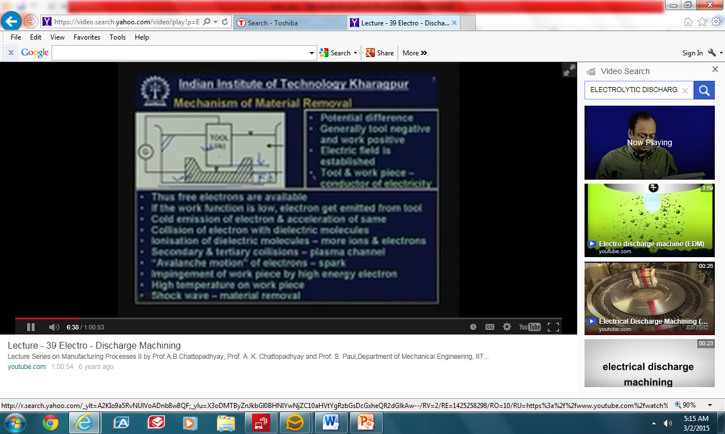

Slide 9
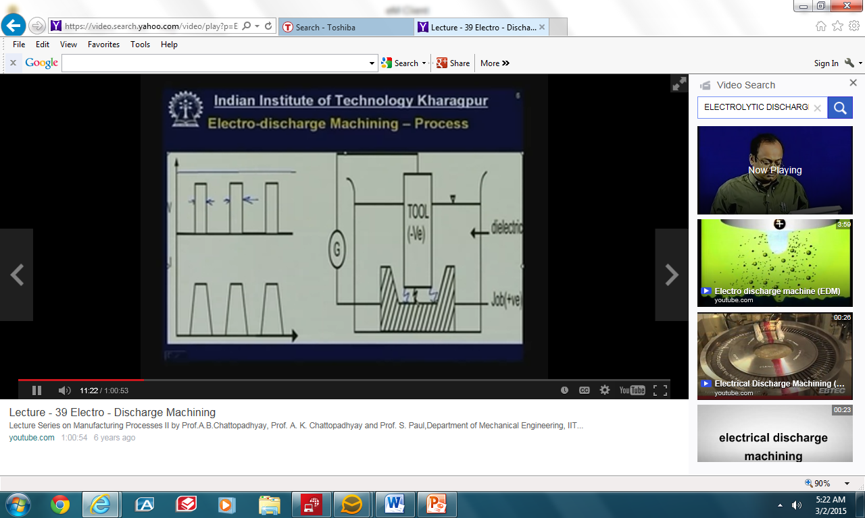
Step waveform not continuous to get a spark not arc

Slide 10
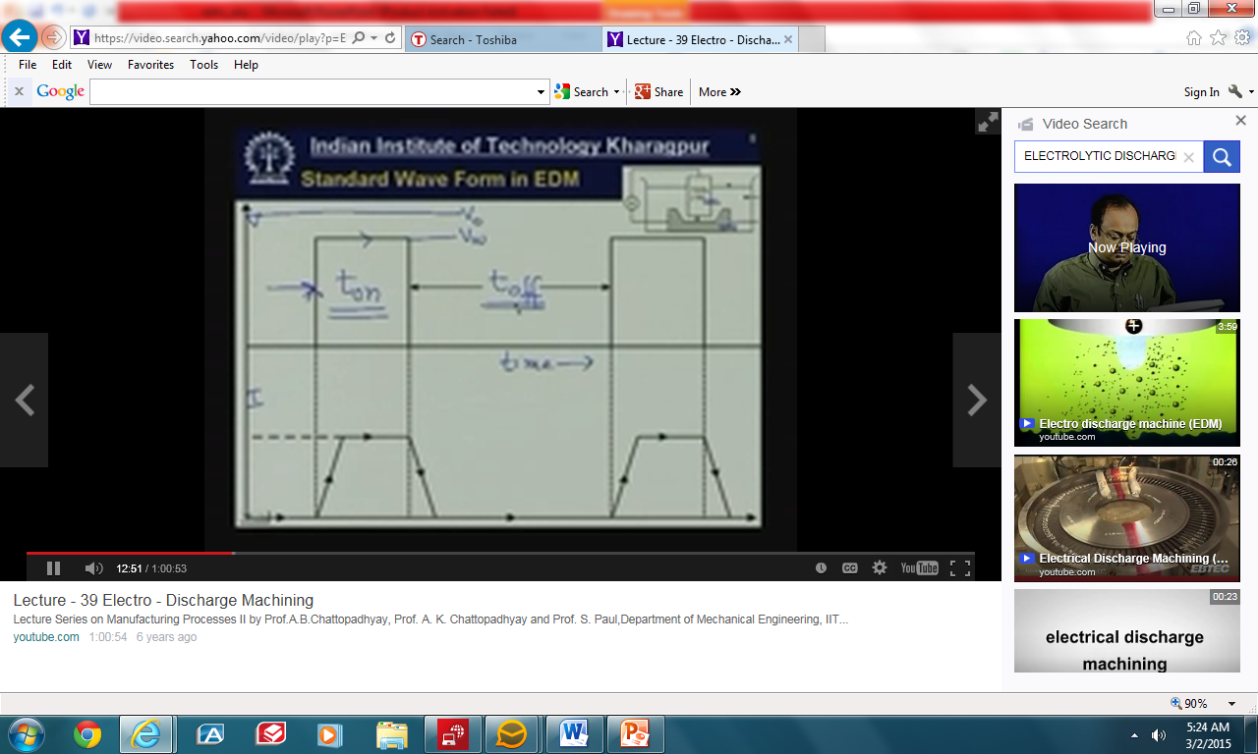
Parameters, ton, toff, Voc, Vw

Slide 11
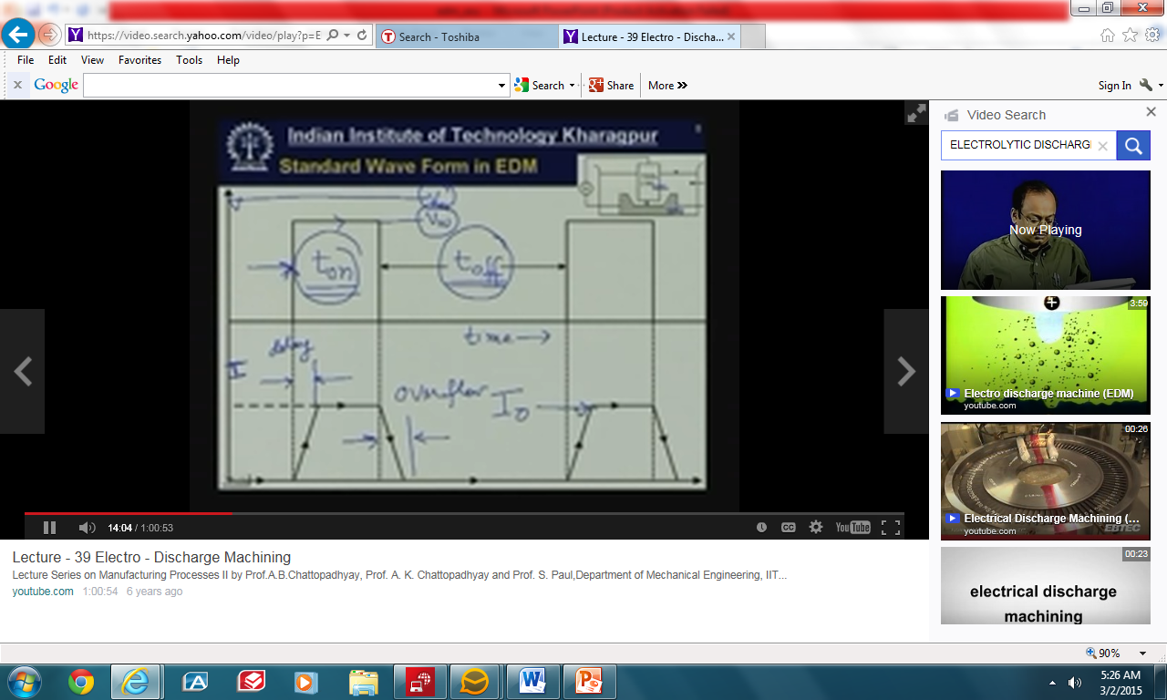

Slide 12
Process Parameters in EDM
The open circuit voltage – V_{t}
_{The working voltage –} V_{h}
_{The maximum current –} I_{o}
_{The pulse on time –} t_{on}
_{The pulse off time –} t_{off}
The gap between the work piece and the tool – spark gap - ȸ
The polarity – straight polarity – tool (-ve)
The dielectric medium
External flushing through the spark gap.

Slide 13
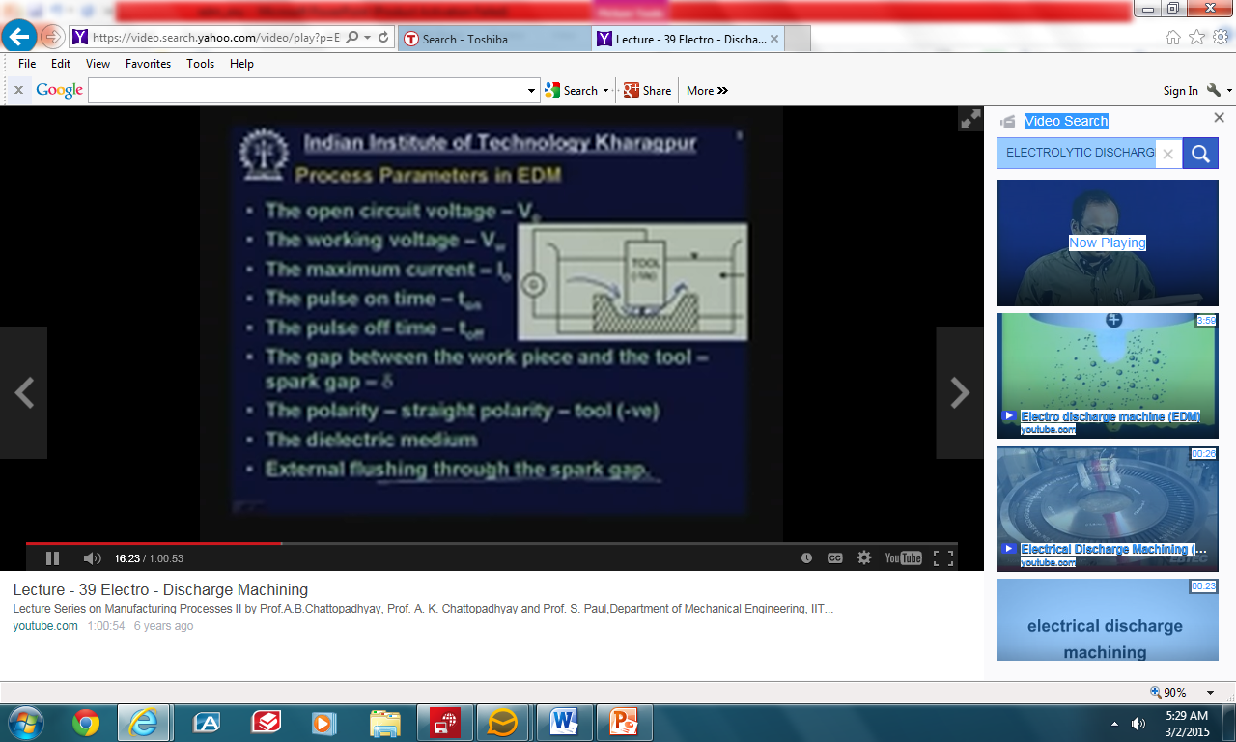

Slide 14
Characteristics of EDM
The process can be used to machine any work material if it is electrically conductive
Material removal depends on mainly thermal properties of the work material rather than its strength, hardness etc

Slide 15
Characteristics of EDM
In EDM there is a physical tool and geometry of the tool is the positive impression of the hole or geometric features to be machined
The tool has to be electrically conductive as well. The tool wear once again depends on the thermal properties of the tool material

Slide 16
Characteristics of EDM
Through the local temperature rise is rather high, still due to very small pulse on time, there is not enough time for the heat to diffuse and thus almost no increase in bulk temperature takes place. Thus the heat affected zone is limited to 2-4 pm of the spark crater
However rapid heating and cooling and local high temperature leads to surface hardening which may be desirable in some applications

Slide 18
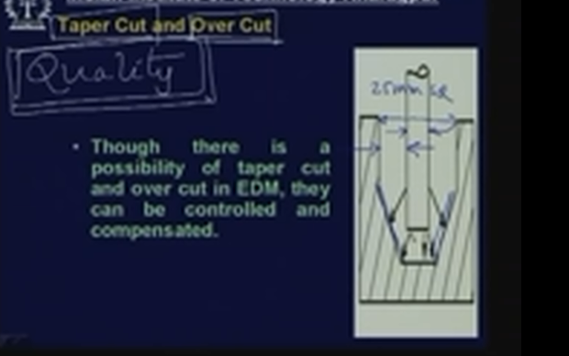
TAPER CUT AND OVER CUT
Though there is a possibility

Slide 19
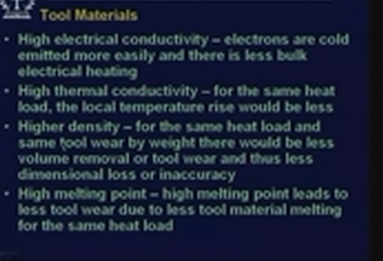

Slide 20
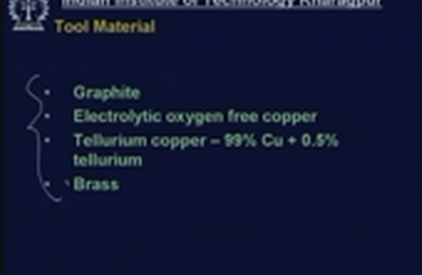

Slide 21
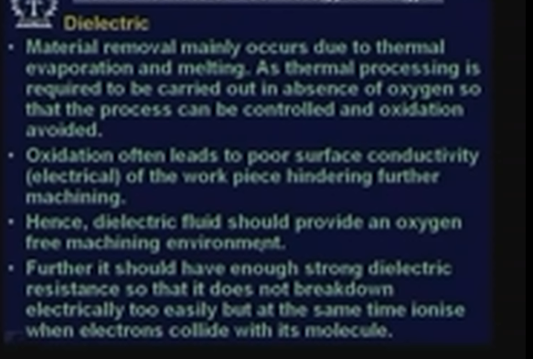

Slide 22
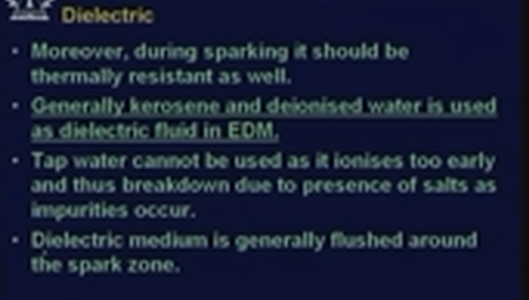

Slide 23
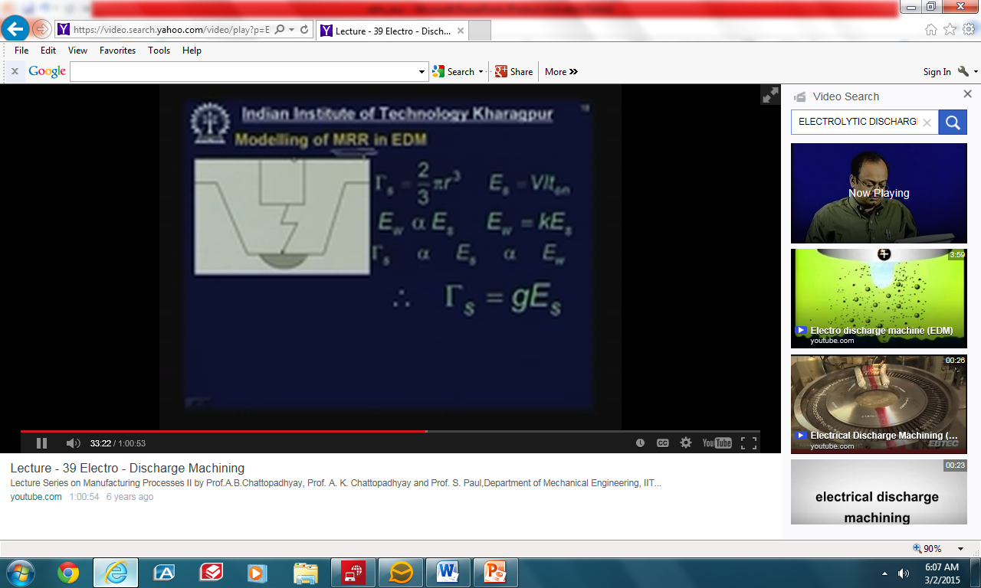

Slide 24
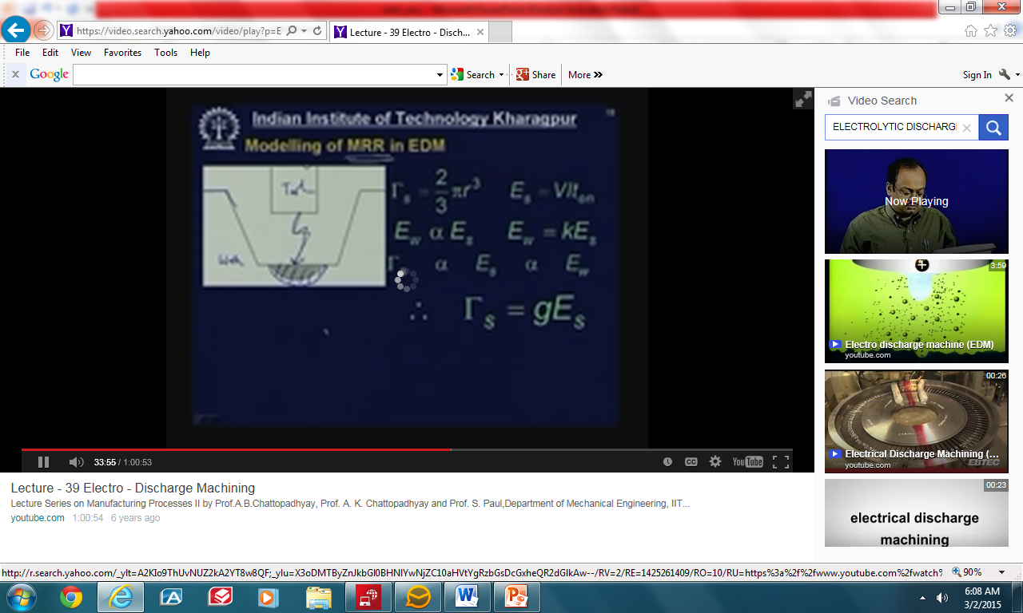

Slide 25
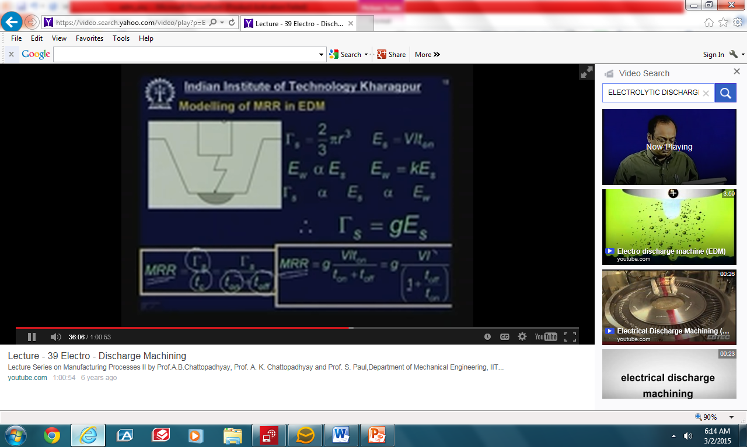

Slide 26
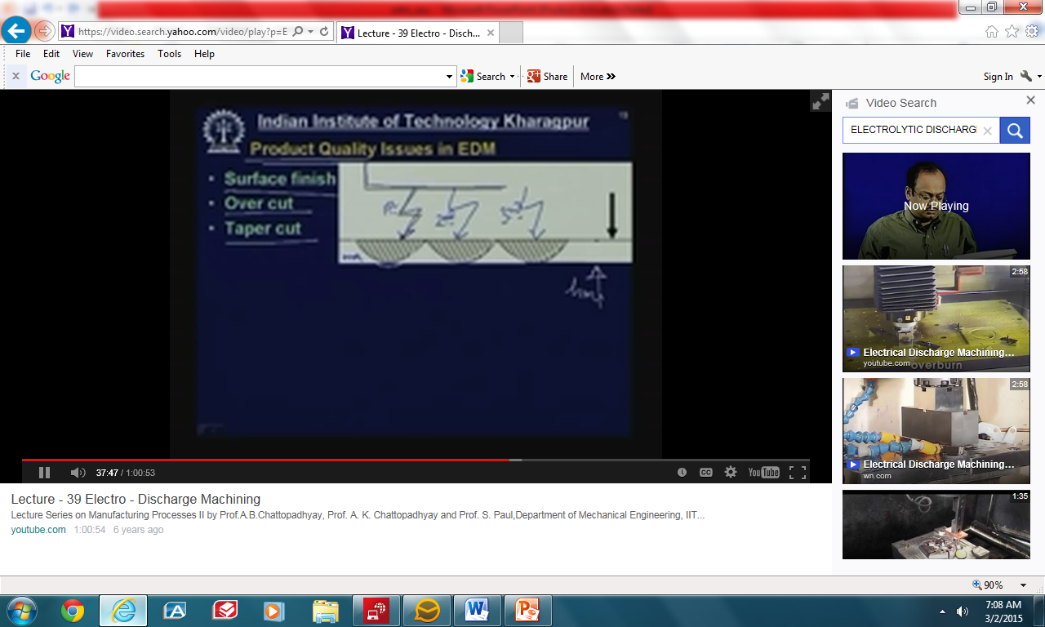
PRODUCT QUALITY ISSUES IN EDM
Surface finish
Over Cut
Taper Cut

Slide 27
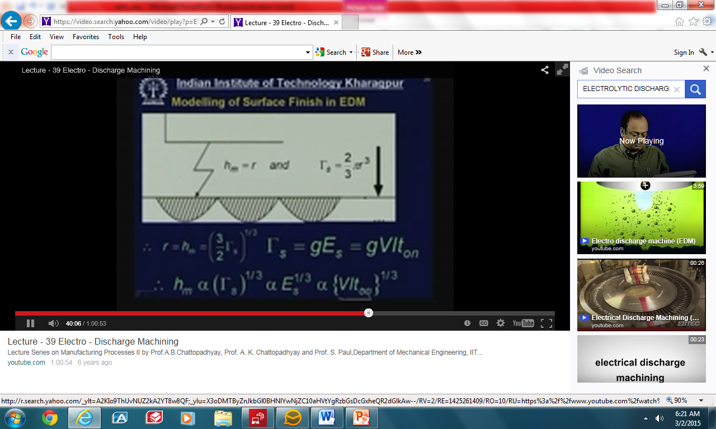

Slide 28
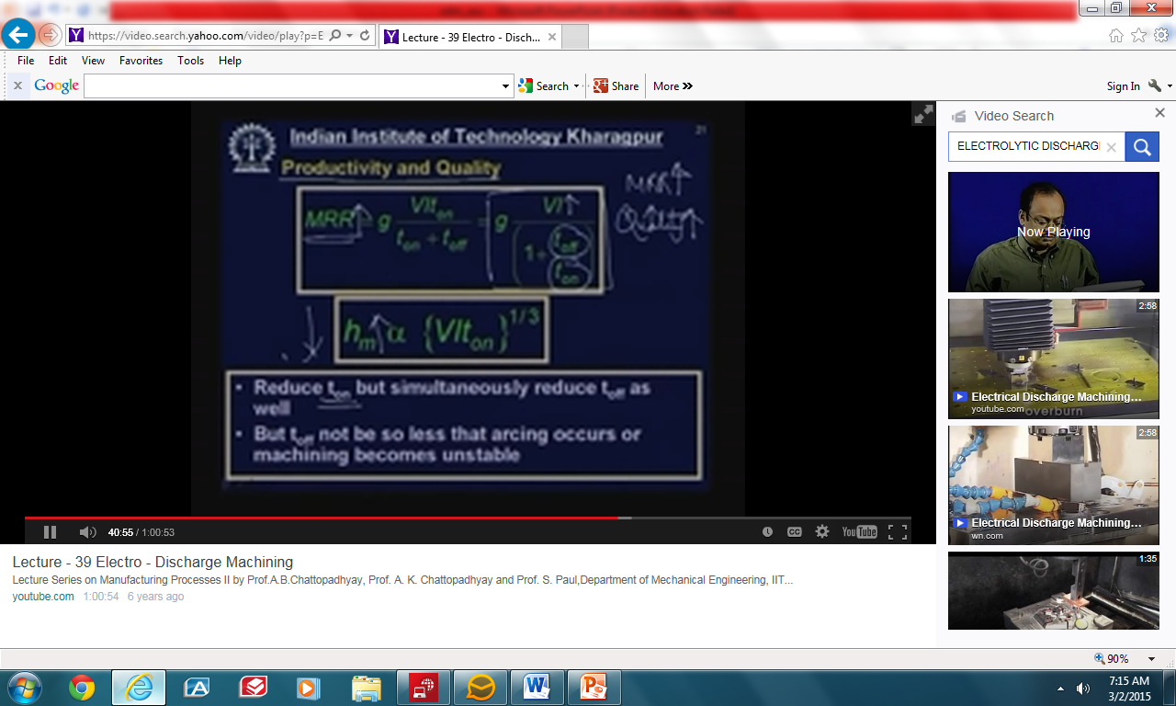

Slide 29
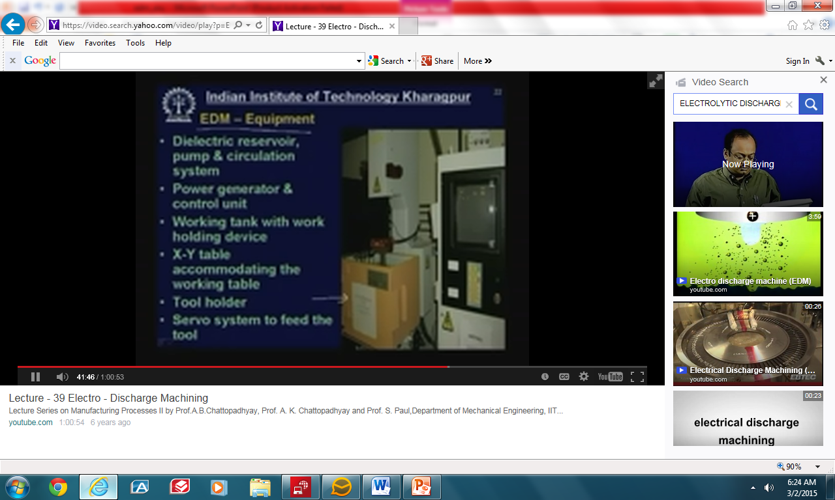
EDM EQUIPMENT
Dielectric reservoir, pump and circulation system
Power generator and control unit
Working tank with work holding device
X-Y tube accommodating the working table
Tool holder
Servo system to feed the tool

Slide 30
TYPES OF EDM GENERATORS
Resistance – Capacitance type (RC)
Rotary generator
Rotary impulse type generator
Electronic pulse generator
Hybrid EDM generator

Slide 31
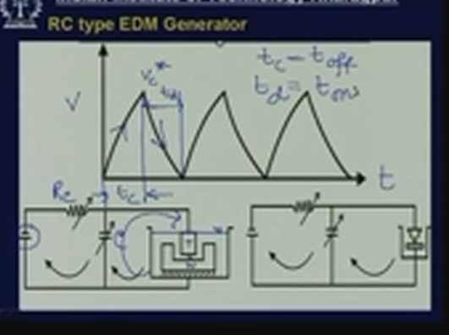

Slide 32
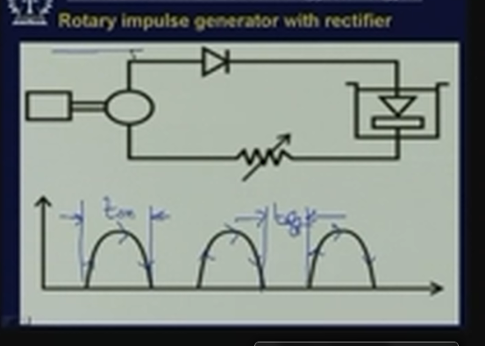

Slide 33
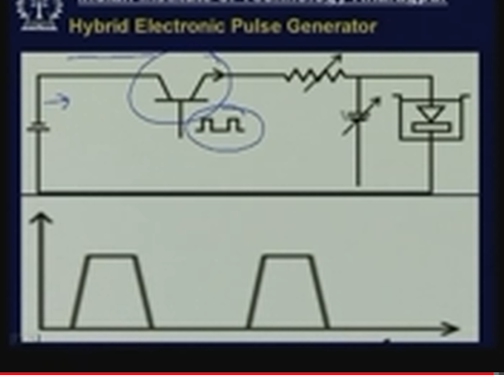

Slide 34
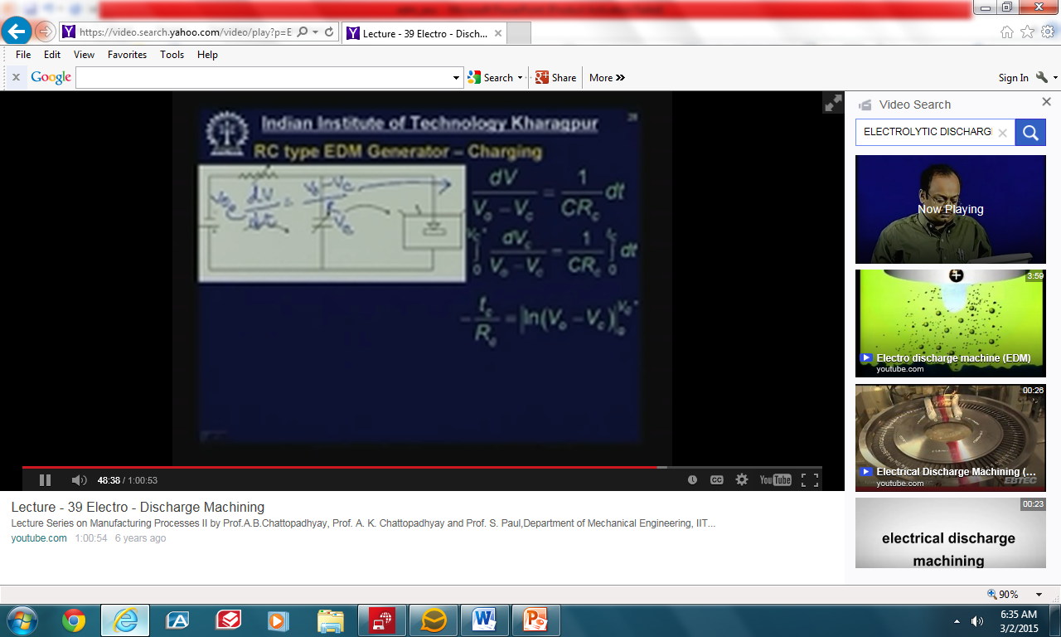

Slide 35
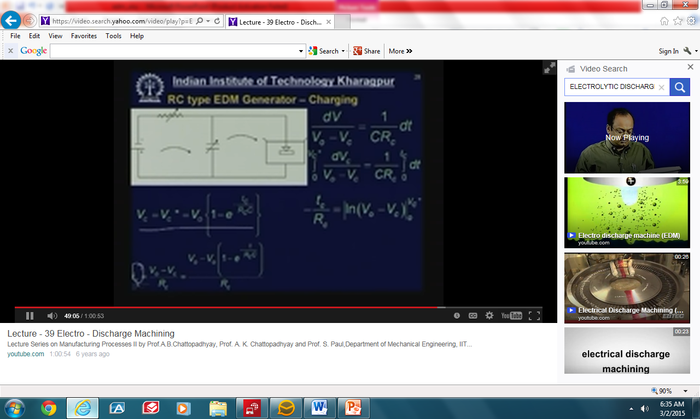

Slide 36
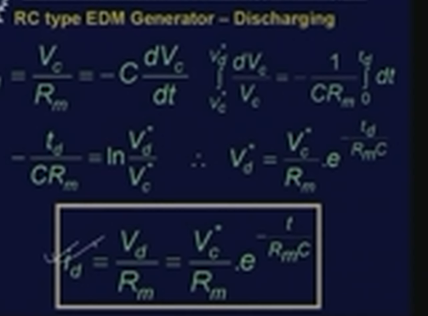

Slide 37
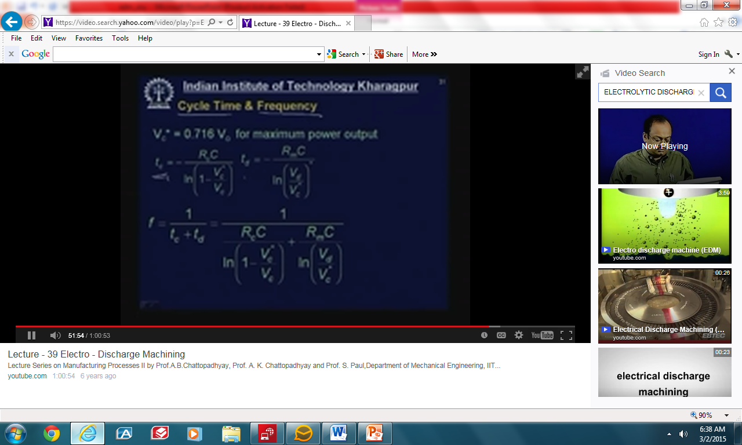

Slide 38
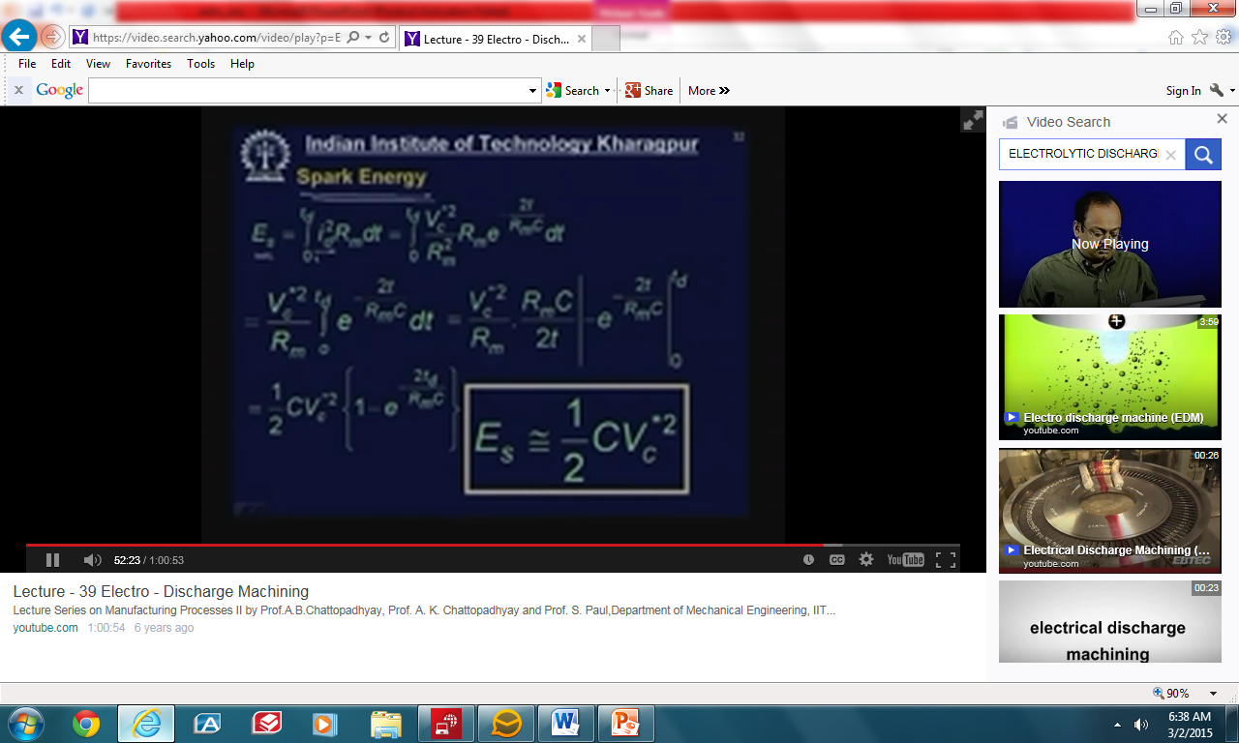

Slide 39
SUMMARY
Basic mechanism of material removal in EDM
Process parameters of EDM and defects on MRR
Different Quality Parameters and their control
Mathematical model relating MRR and surface roughness with EDM parameters
Major components of EDM equipment
Analysis of RC type generator

Slide 40
QUIZ
Which of the following material cannot be maintained by EDM
Steel
WC
Titanium
Glass
Which of the following is used as dielectric medium in EDM
Tap water
Kerosene
NaCl solution
KOH Solution

Slide 41
QUIZ
3. EDM tool should not have
High machinability
Low thermal conductivity
High melting point
High specific heat
4. EDM tool material should be
Electrical insulator
Electrically conductive
Very hard
thermal insulators

Slide 42
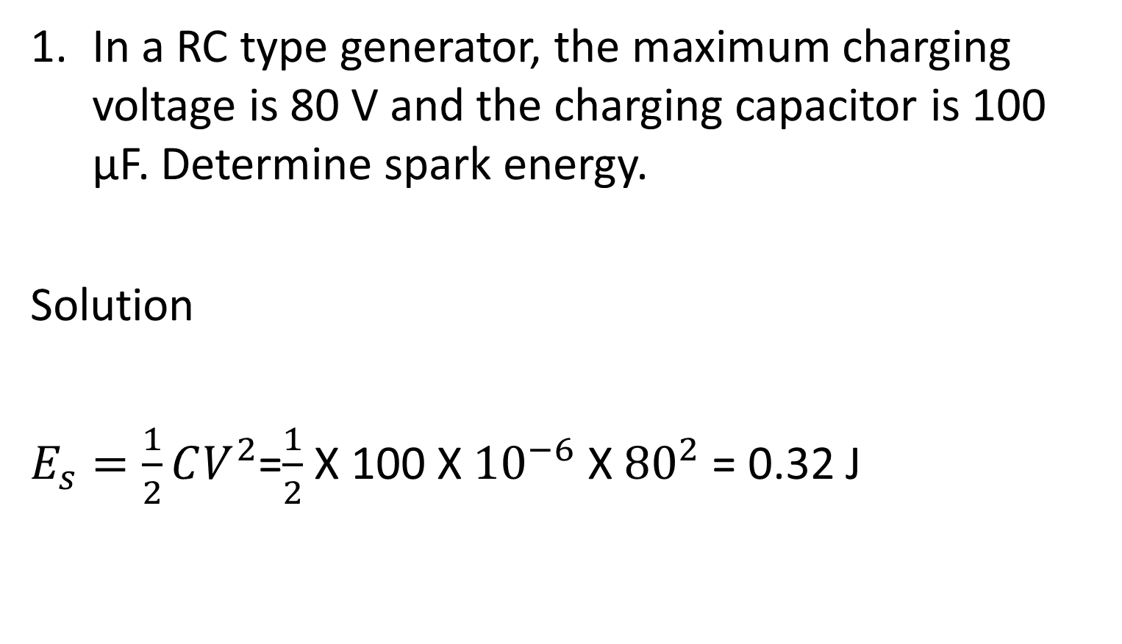
SOLVED PROBLEM
In a RC type generator, the maximum charging voltage is 80 V and the charging capacitor is 100 μF. Determine spark energy.
Solution
$E_{s}=\frac{1}{2}CV^{2}$=$\frac{1}{2}$X 100 X ${10}^{−6}$ X ${80}^{2}$ = 0.32 J

